Slide 1


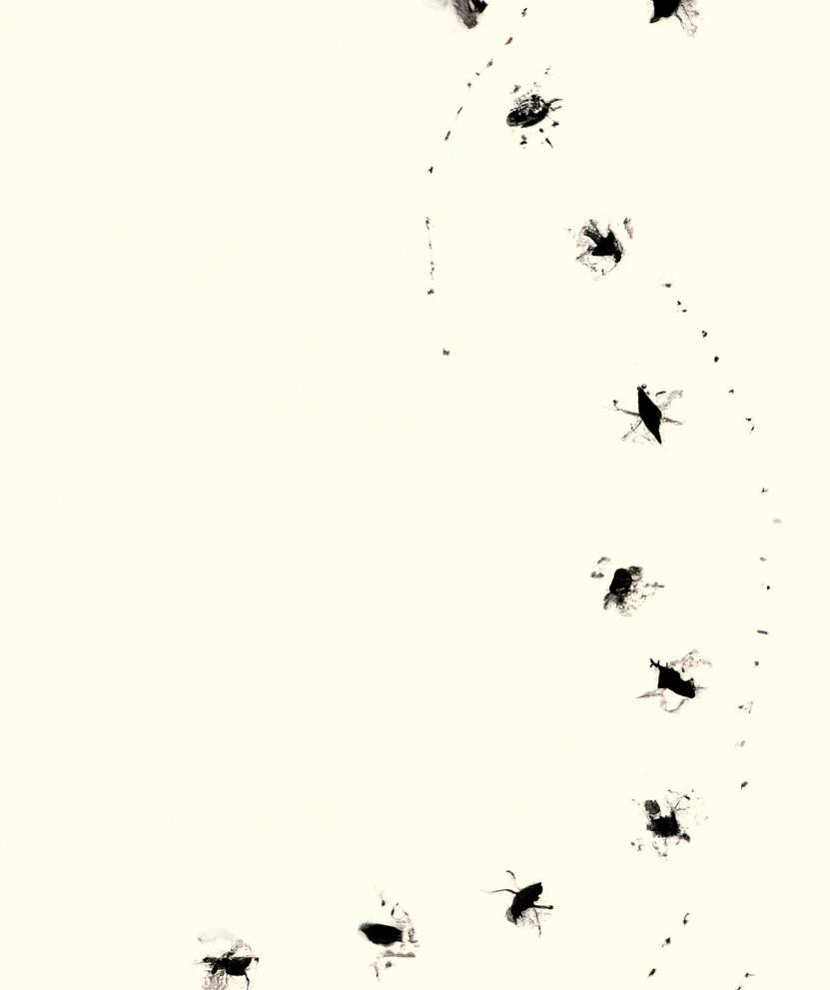
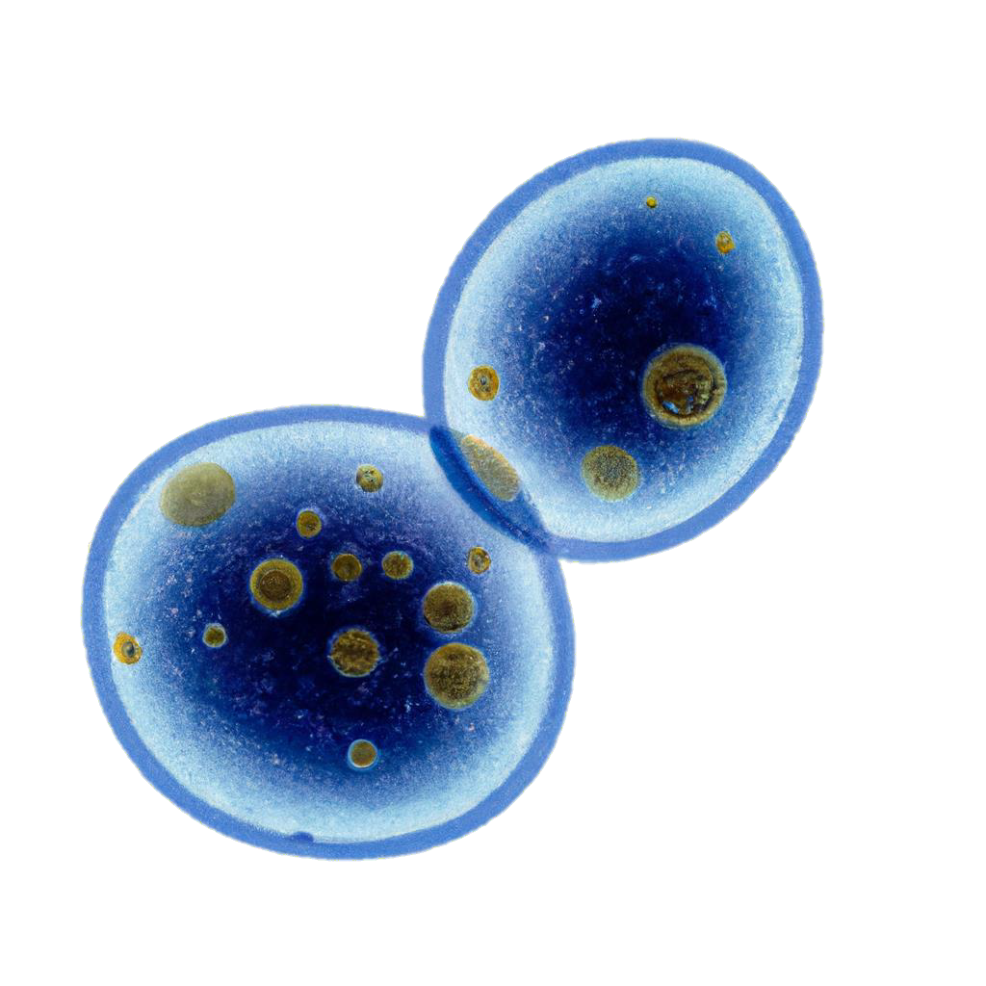

Unravelling Sex-Specific Aging on Flies: A Deep Learning Approach – Age Update
Presented by Nikolai Tennant,
Researcher at Ritambhara Singh's Lab
Brown University & IISAGE

Slide 2

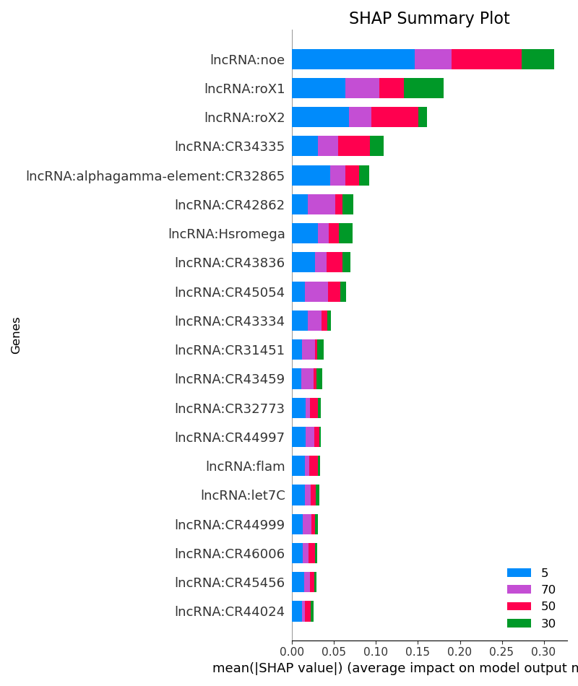
AGE – All Cell Types (Head)
Figure 1 : Age SHAP Summary Plot – Only lncRNA Genes (ACC: 65%, AUC: 89)

Slide 3
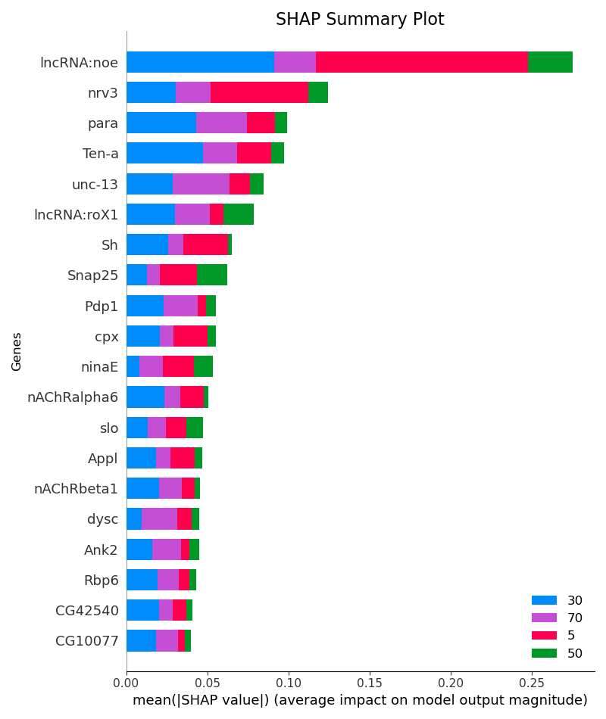
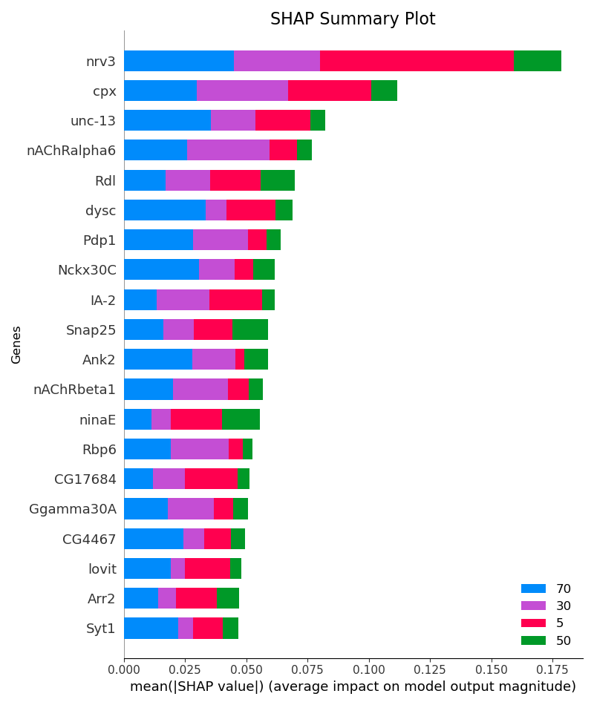
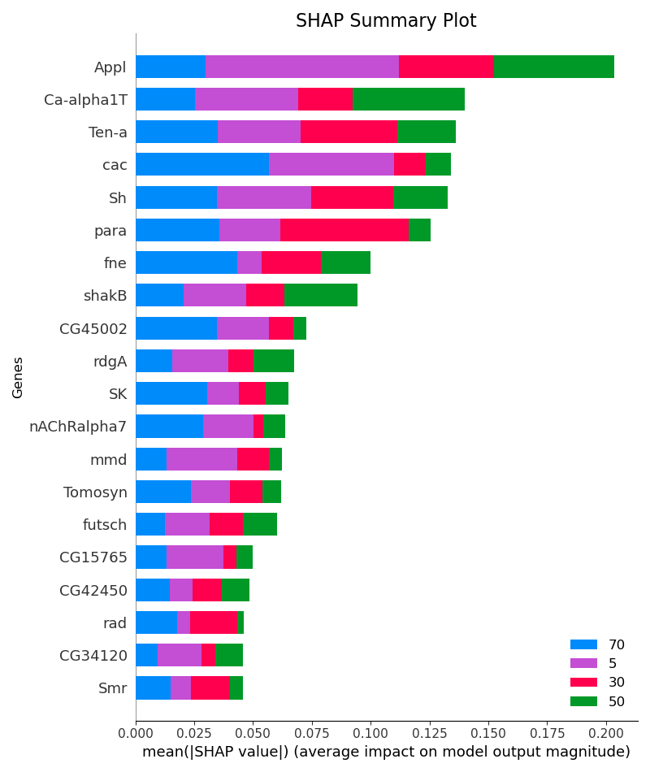
AGE – Epithelial Cells (Head)
Figure 11 : Age SHAP Summary Plot – All Genes (ACC: 61%, AUC: 85)
Figure 12 : Age SHAP Summary Plot – Only Autosomal Genes (ACC: 52%, AUC: 79)
Figure 13 : Age SHAP Summary Plot – Only Sex Genes (ACC: 37%, AUC: 68)

Slide 4
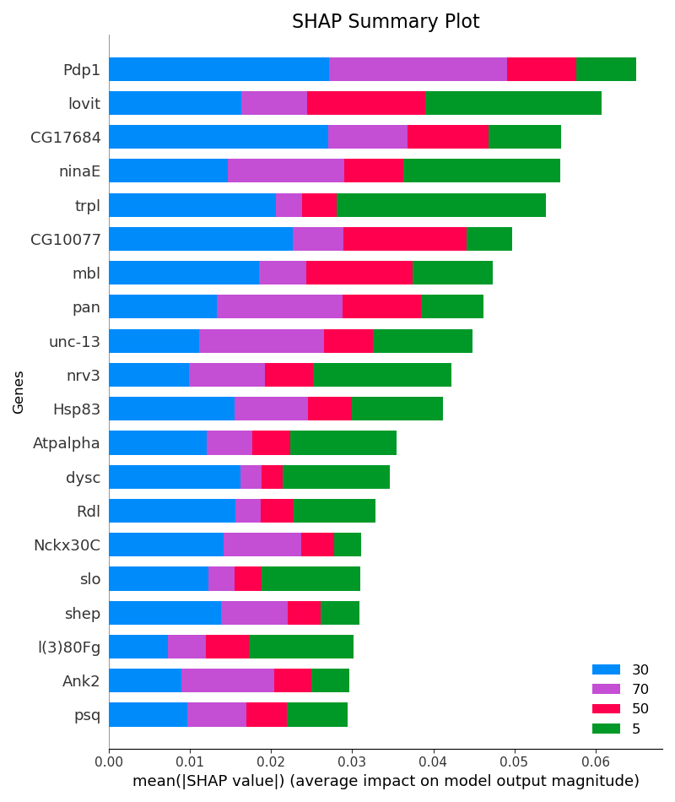
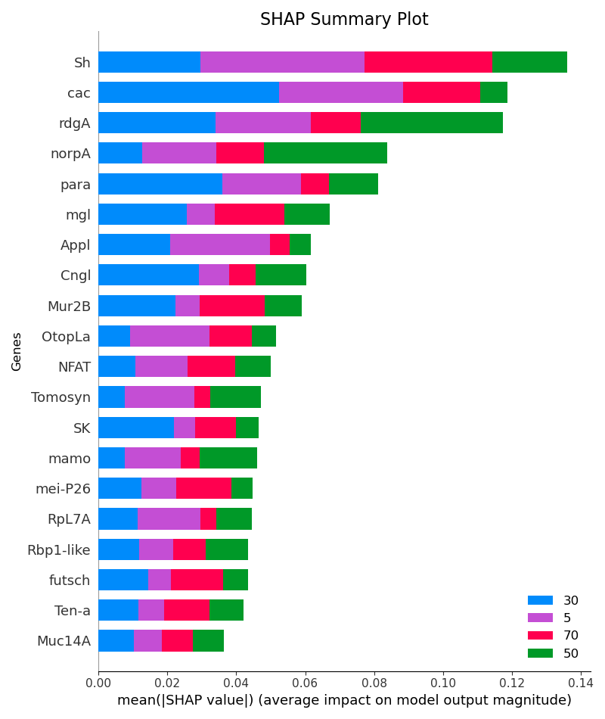
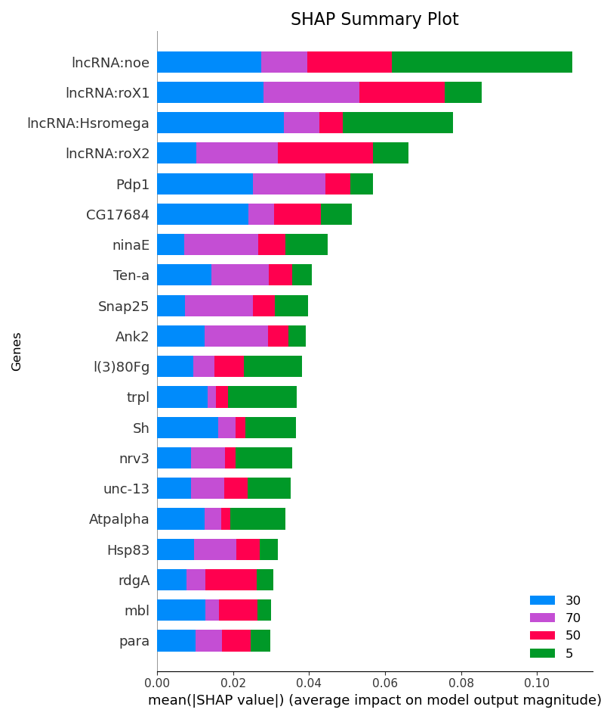
AGE – Glial Cells (Head)
Figure 5 : Age SHAP Summary Plot – All Genes ((ACC: 77%, AUC: 94)
Figure 6 : Age SHAP Summary Plot – Only Autosomal Genes (ACC: 75%, AUC: 93)
Figure 7 : Age SHAP Summary Plot – Only Sex Genes (ACC:57 %, AUC: 79)

Slide 5
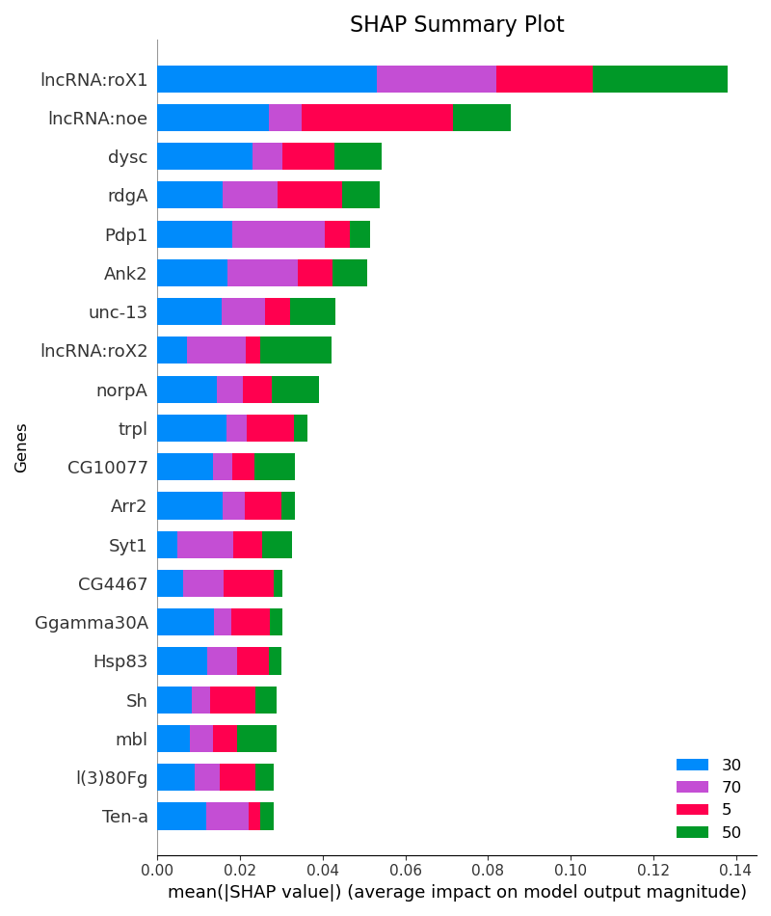
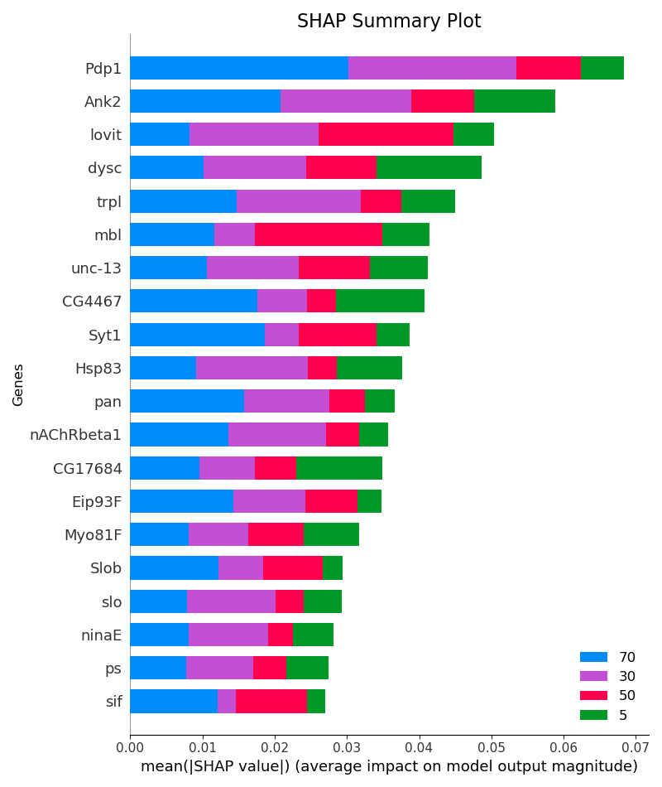
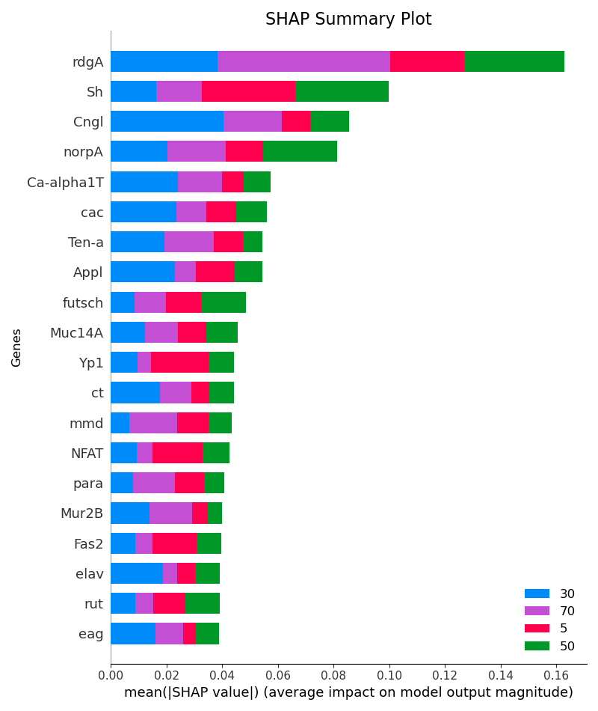
AGE - Sensory Neurons (Head)
Figure 8 : Age SHAP Summary Plot – All Genes (ACC: 79%, AUC: 95)
Figure 9 : Age SHAP Summary Plot – Only Autosomal Genes (ACC: 77%, AUC: 94)
Figure 10 : Age SHAP Summary Plot – Only Sex Genes (ACC: 62%, AUC: 85)

Slide 6
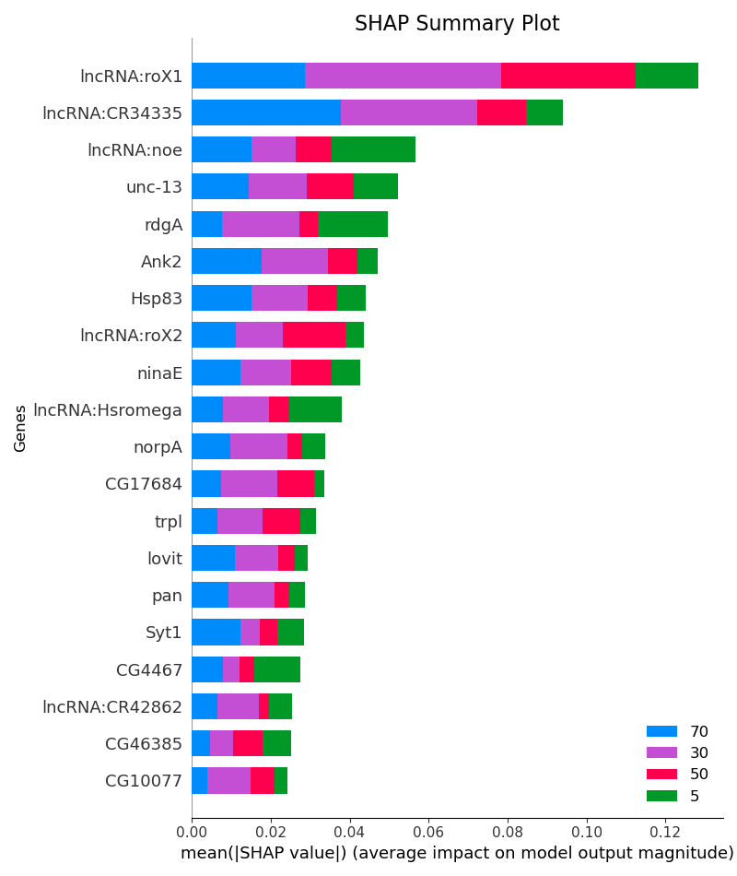
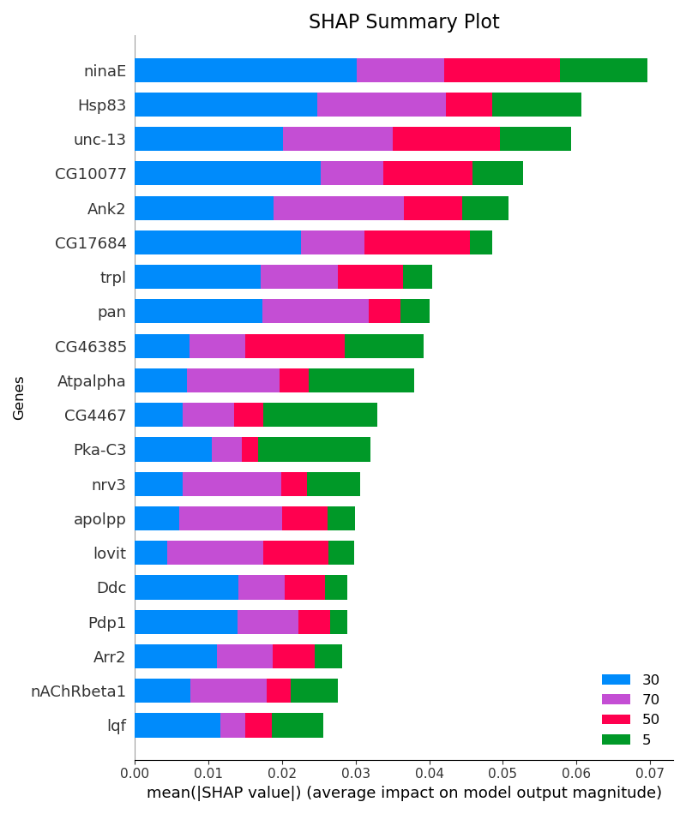
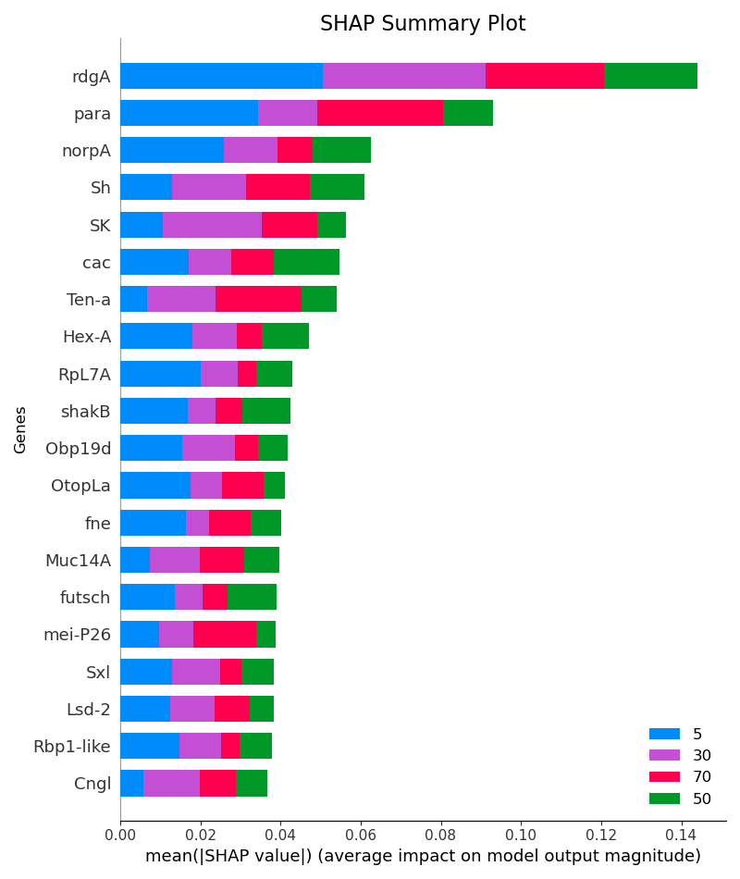
AGE – CNS Neurons (Head)
Figure 2 : Age SHAP Summary Plot – All Genes (ACC: 80%, AUC: 93)
Figure 3 : Age SHAP Summary Plot – Only Autosomal Genes (ACC:77 %, AUC: 92)
Figure 4 : Age SHAP Summary Plot – Only Sex Genes (ACC: 65%, AUC: 86)

